Slide 1
Business Intelligence
Session 1
Farha Imthiyaz,
BSc (Hons) in Software Engineering
(Solent University, UK),
MS in Data Science (Reading)
(NED University of Engineering & Technology, Karachi)

Slide 2

Road Map
Understanding Business Intelligence (BI)
BI Examples
Importance of BI
Pros & Cons of BI
Case Study
BI Software Tools
BI Tools Comparison
BI Vs DS
Summary

Slide 3
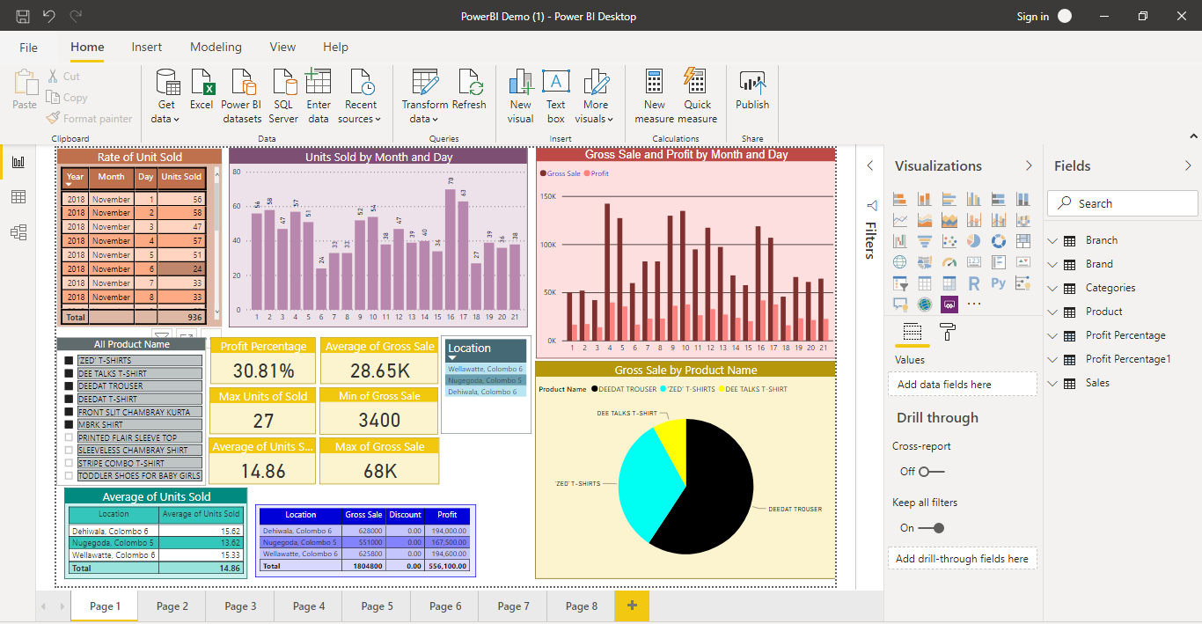
BI Output

Slide 4

Business Intelligence (BI)
BI is a set of processes, architectures, and technologies that convert raw data into meaningful information that drives profitable business actions.

Slide 5
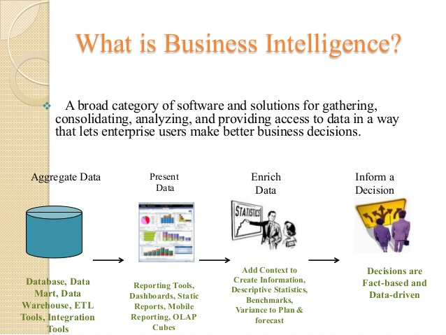
BI Cont..

Slide 6
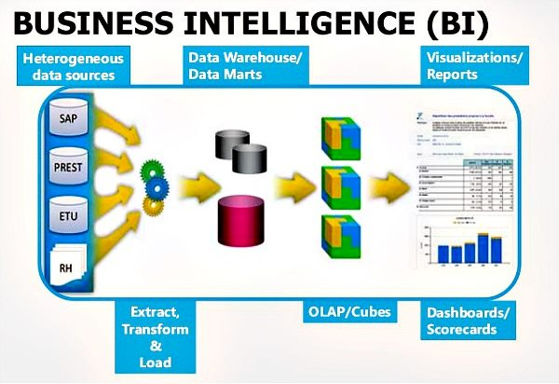
BI Cont..

Slide 7
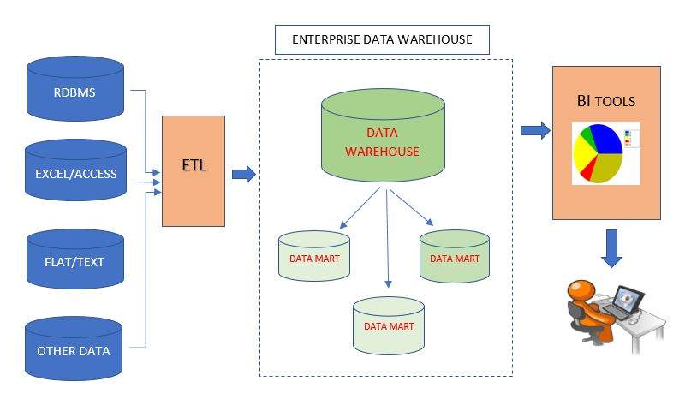
BI Cont..

Slide 8
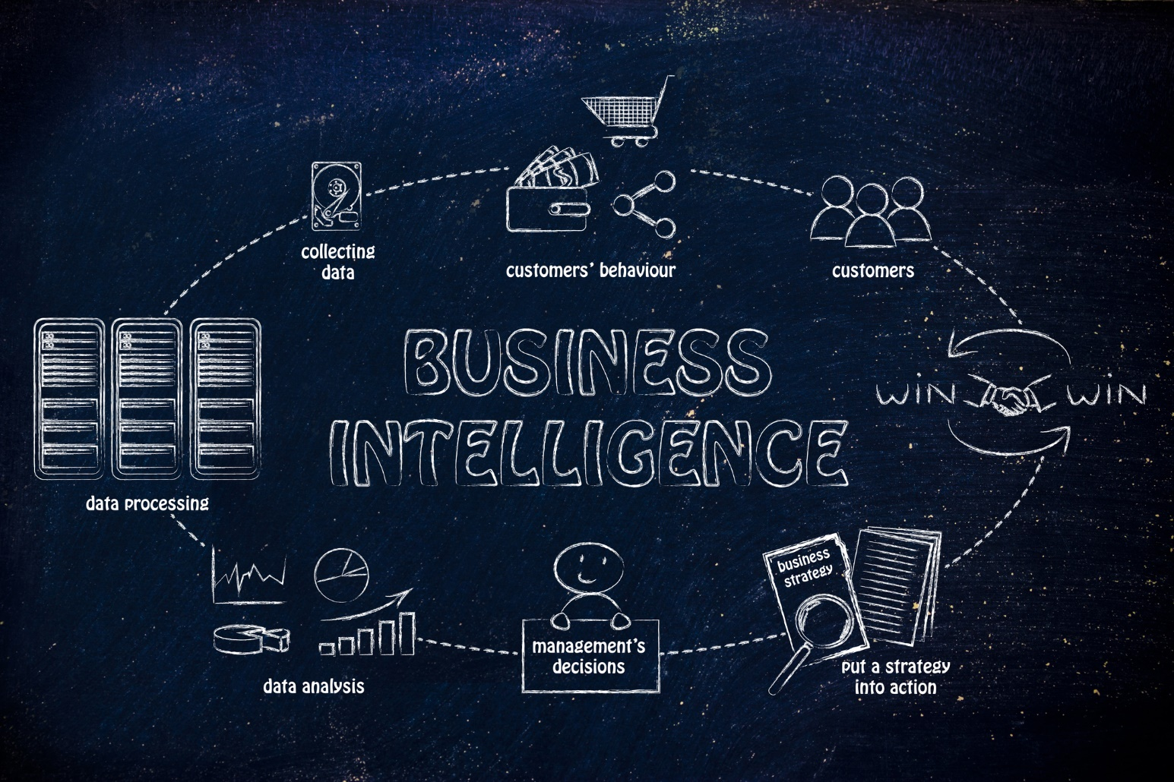
BI Cont..

Slide 9
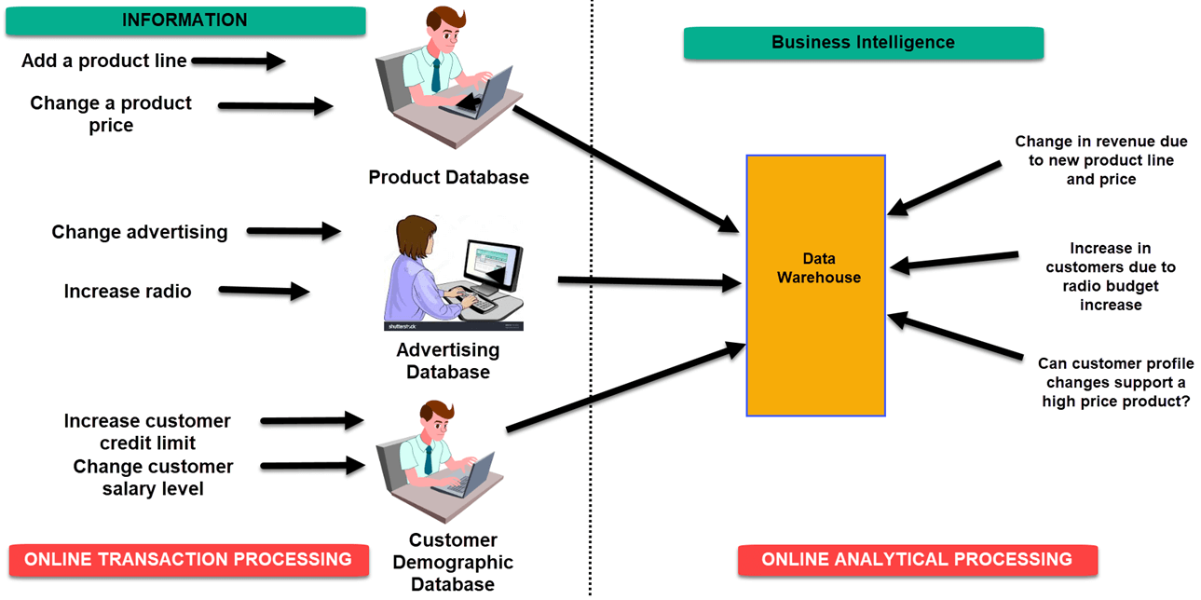
BI Example - 1

Slide 10
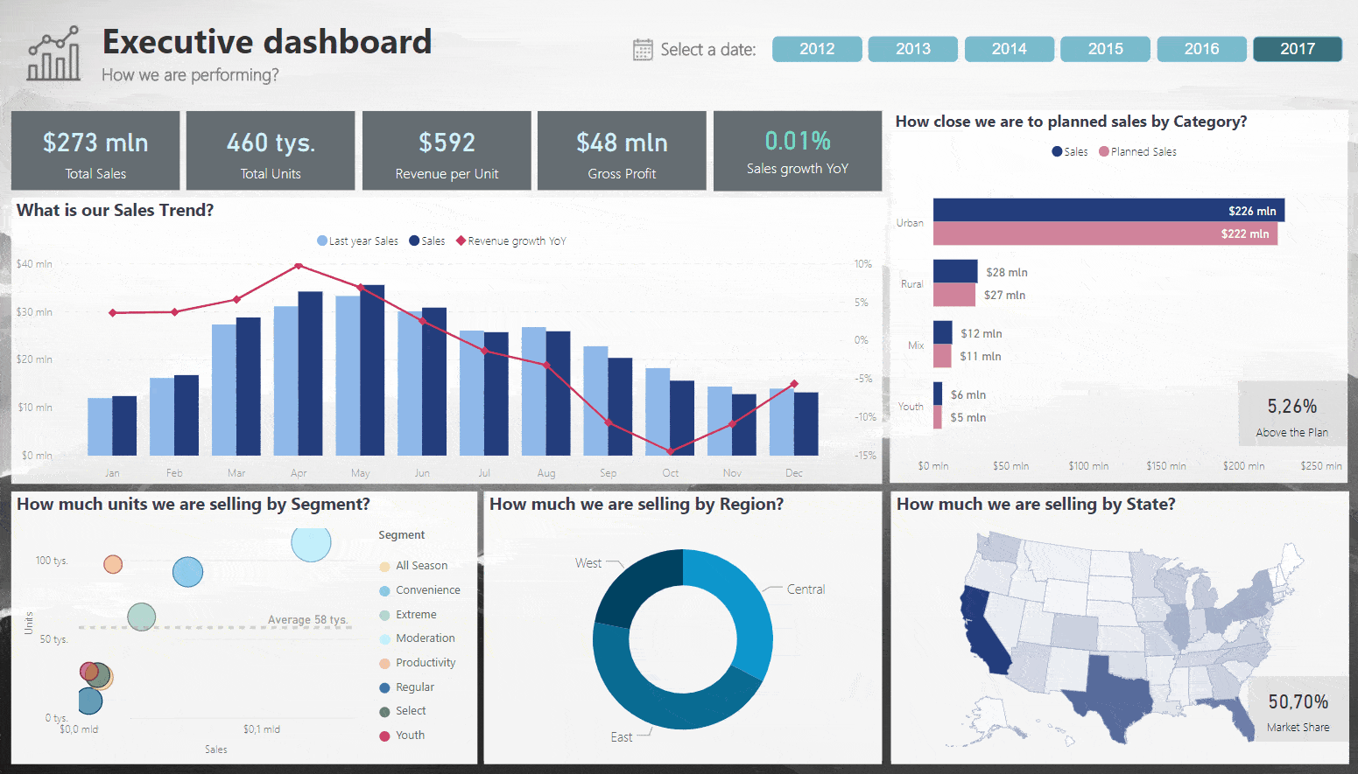
BI Example - 2

Slide 11

BI Example - 3

Slide 12
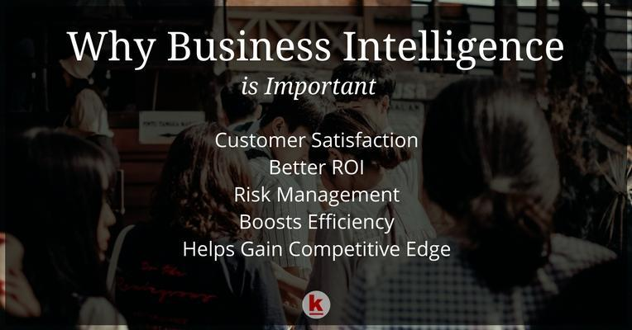
Importance of BI

Slide 13
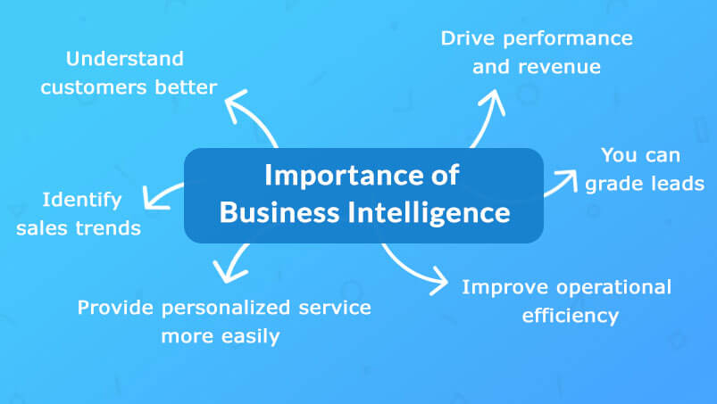
Importance of BI Cont..

Slide 14
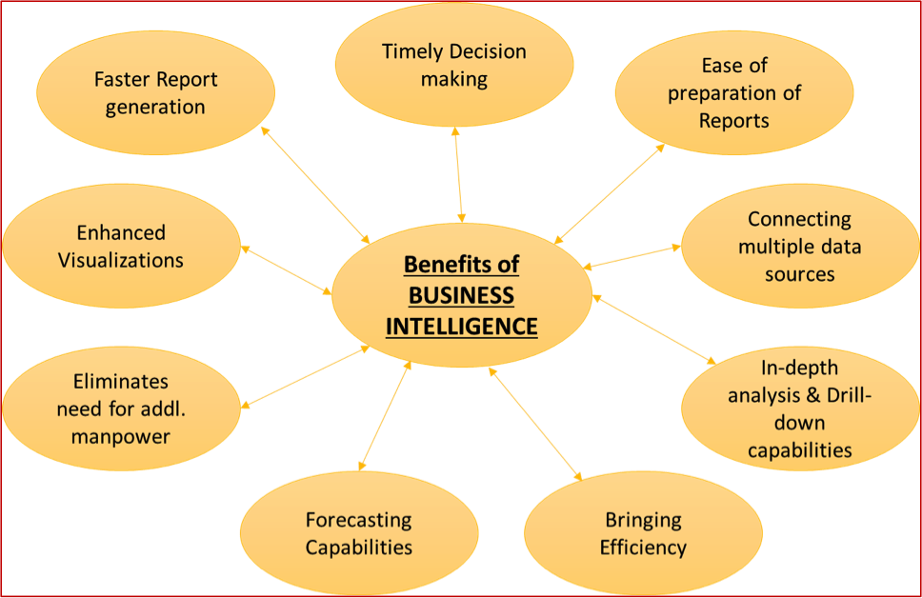
Advantages of BI

Slide 15
Disadvantages of BI
Cost
Complexity
Limited use
Time Consuming Implementation

Slide 16

Case Study
Imtiaz is the pioneer in the retail industry of Pakistan, providing an ultimate shopping experience to its consumers. To improve their business strategy Top management of Imtiaz trying to use BI software tool for their business. You are the Business Intelligence team. They are requesting you to suggest best and easy usable BI tool for their business.
Explain what is BI Software Tools & Examples
Explain Comparison between BI Software Tools
Explain what are the your suggestions BI tools (two) for them with reasons (Why you select them)
Get into groups
Read and analyze the case study
Present the results

Slide 17
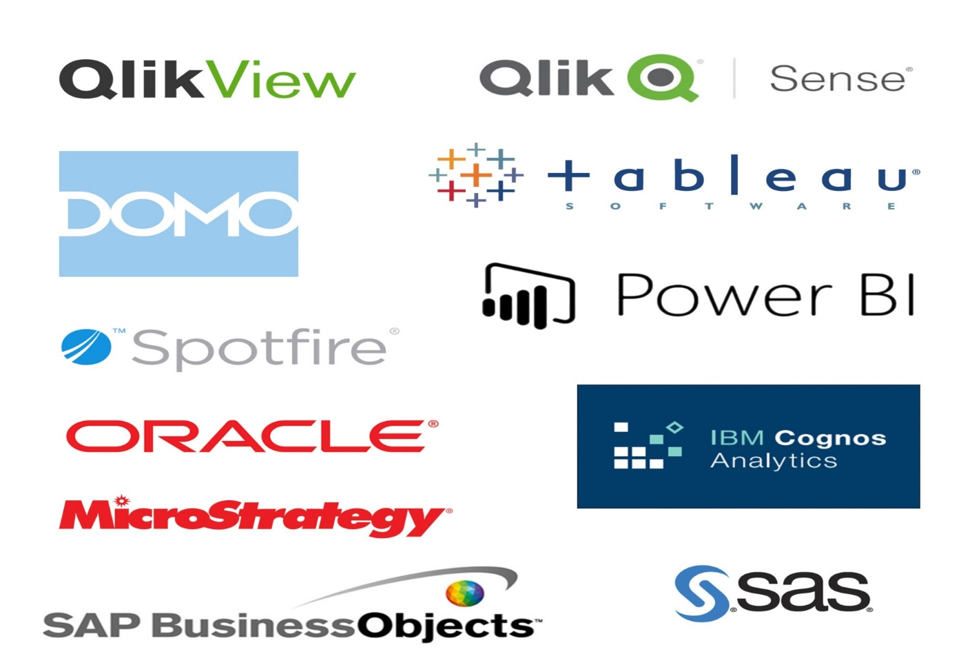
BI Software Tools

Slide 18
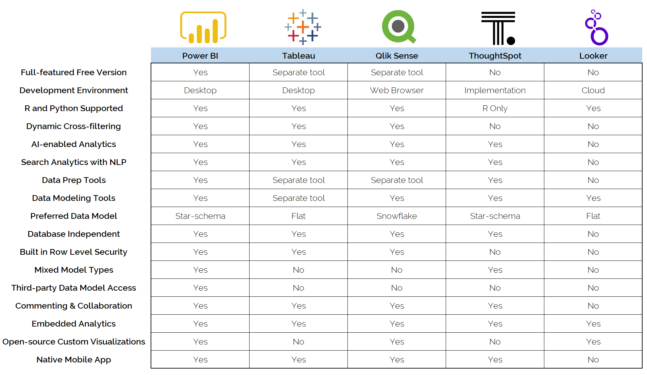
BI Tools Comparison

Slide 19
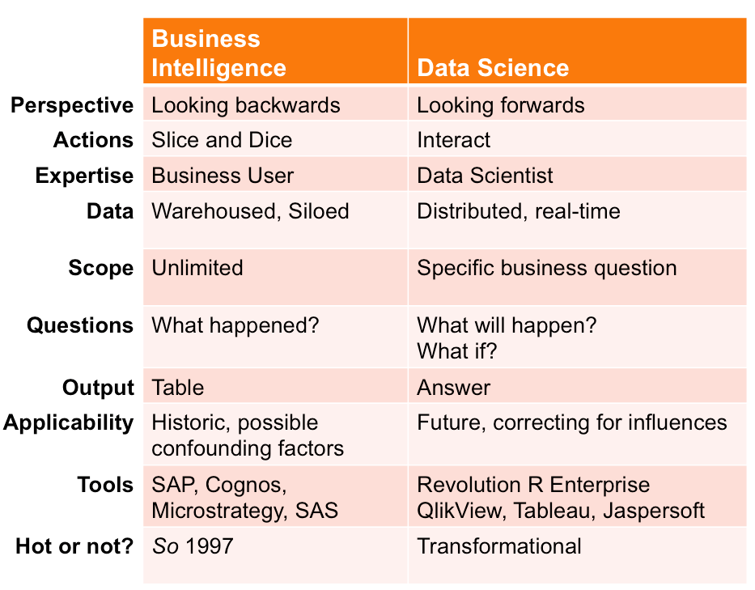
BI Vs DS

Slide 20
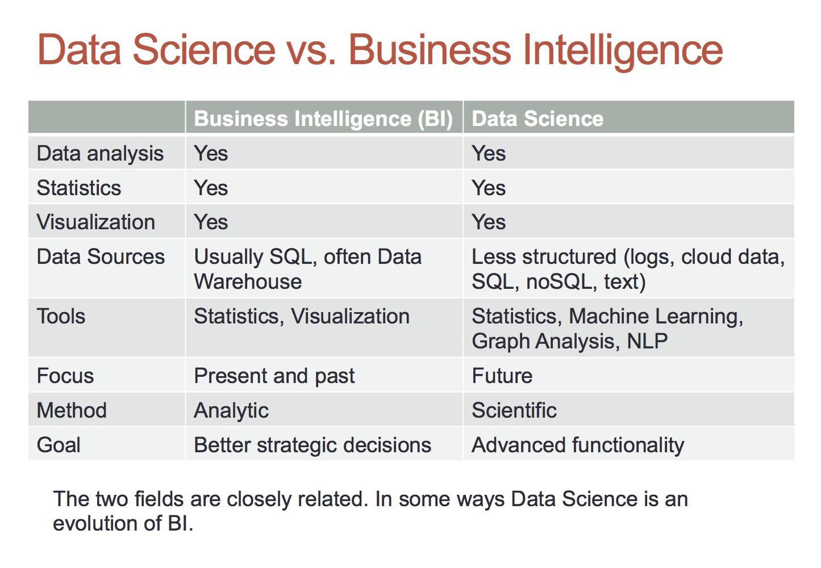
BI Vs DS Cont..

Slide 21
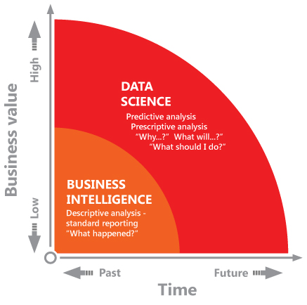
BI Vs DS Cont..

Slide 22

Summary
Business intelligence (BI) is a technology-driven process for analyzing data and presenting actionable information to help executives, managers and other corporate end users make informed business decisions.

Slide 23
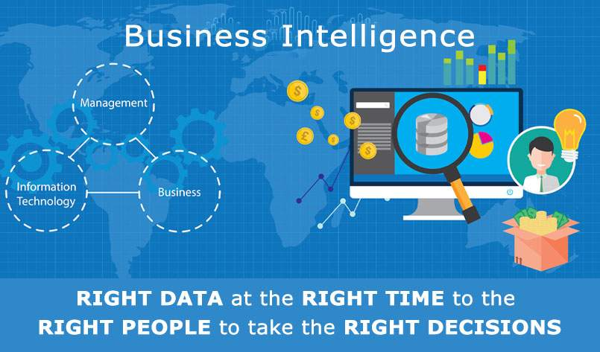
Summary Cont..

Slide 24


Slide 25



